Slide 1
Spring Boot

Slide 2
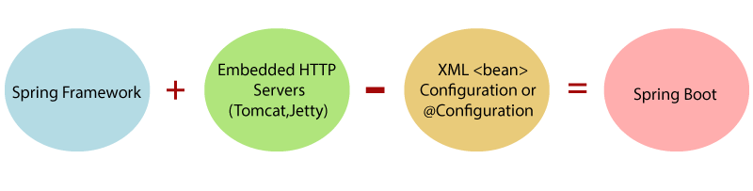
What is Spring Boot
Spring Boot is a project that is built on the top of the Spring Framework.
It provides an easier and faster way to set up, configure, and run both simple and web-based applications.
It is a Spring module that provides the RAD (Rapid Application Development) feature to the Spring Framework.
In short, Spring Boot is the combination of Spring Framework and Embedded Servers.

Slide 3
Why Spring Boot Framework?
The dependency injection approach is used in Spring Boot.
It contains powerful database transaction management capabilities.
It simplifies integration with other Java frameworks like JPA/Hibernate ORM, Struts, etc.
It reduces the cost and development time of the application.

Slide 4
Advantages of Spring Boot
It creates stand-alone Spring applications that can be started using Java -jar.
It tests web applications easily with the help of different Embedded HTTP servers such as Tomcat, Jetty, etc. We don't need to deploy WAR files.
It provides opinionated 'starter' POMs to simplify our Maven configuration.
There is no requirement for XML configuration.
It offers a CLI tool for developing and testing the Spring Boot application.
It offers the number of plug-ins.
It also minimizes writing multiple boilerplate codes (the code that has to be included in many places with little or no alteration), XML configuration, and annotations.
It increases productivity and reduces development time.

Slide 5
Limitations of Spring Boot
Spring Boot can use dependencies that are not going to be used in the application. These dependencies increase the size of the application.

Slide 6
Goals of Spring Boot
The main goal of Spring Boot is to reduce development, unit test, and integration test time.
- Provides Opinionated Development approach
- Avoids defining more Annotation Configuration
- Avoids writing lots of import statements
- Avoids XML Configuration.
By providing or avoiding the above points, Spring Boot Framework reduces Development time, Developer Effort, and increases productivity.

Slide 7
Spring Boot Features
Web Development :
- It is a well-suited Spring module for web application development.
- We can easily create a self-contained HTTP application that uses embedded
servers like Tomcat, Jetty, or Undertow.
- We can use the spring-boot-starter-web module to start and run the
application quickly.
SpringApplication :
- The SpringApplication is a class that provides a convenient way to bootstrap
a Spring application.
- It can be started from the main method. We can call the application just by
calling a static run() method.

Slide 8
Spring Boot Features
Application events and listeners :
- Spring Boot uses events to handle the variety of tasks. It allows us to create
factories file that is used to add listeners.
- We can refer it to using the ApplicationListener key.
- Always create factories file in META-INF folder like META-INF/spring.factories.
Admin features :
- Spring Boot provides the facility to enable admin-related features for the
application.
- It is used to access and manage applications remotely.
- We can enable it in the Spring Boot application by using
spring.application.admin.enabled property.

Slide 9
Spring Boot Features
Externalized Configuration :
- Spring Boot allows us to externalize our configuration so that we can work
with the same application in different environments.
- The application uses YAML files to externalize configuration.
Properties Files :
- Spring Boot provides a rich set of Application Properties. So, we can use that
in the properties file of our project.
- The properties file is used to set properties like server-port =8082 and many
others.
- It helps to organize application properties.

Slide 10
Spring Boot Features
YAML Support :
- It provides a convenient way of specifying the hierarchical configuration.
- It is a superset of JSON.
- The SpringApplication class automatically supports YAML.
- It is an alternative of properties file.
Type-safe Configuration :
- The strong type-safe configuration is provided to govern and validate the
configuration of the application. Application configuration is always a crucial
task which should be type-safe.
- We can also use annotation provided by this library.

Slide 11
Spring Boot Features
Logging :
- Spring Boot uses Common logging for all internal logging. Logging
dependencies are managed by default.
- We should not change logging dependencies if no customization is needed.
Security :
- Spring Boot applications are spring based web applications. So, it is secure by
default with basic authentication on all HTTP endpoints.
- A rich set of Endpoints is available to develop a secure Spring Boot
application.

Slide 12
Spring vs. Spring Boot
Spring:
- Spring Framework is the most popular application development framework of Java.
- The main feature of the Spring Framework is dependency Injection or Inversion of
Control (IoC).
- With the help of Spring Framework, we can develop a loosely coupled application.
- It is better to use if application type or characteristics are purely defined.
Spring Boot:
- Spring Boot is a module of Spring Framework.
- It allows us to build a stand-alone application with minimal or zero configurations.
- It is better to use if we want to develop a simple Spring-based application or
RESTful services.

Slide 13
Spring vs. Spring Boot
Spring | Spring Boot
Spring Framework is a widely used Java EE framework for building applications. | Spring Boot Framework is widely used to develop REST APIs.
It aims to simplify Java EE development that makes developers more productive. | It aims to shorten the code length and provide the easiest way to develop Web Applications.
The primary feature of the Spring Framework is dependency injection. | The primary feature of Spring Boot is Autoconfiguration. It automatically configures the classes based on the requirement.
It helps to make things simpler by allowing us to develop loosely coupled applications. | It helps to create a stand-alone application with less configuration.
The developer writes a lot of code (boilerplate code) to do the minimal task. | It reduces boilerplate code.
To test the Spring project, we need to set up the sever explicitly. | Spring Boot offers embedded server such as Jetty and Tomcat, etc.
It does not provide support for an in-memory database. | It offers several plugins for working with an embedded and in-memory database such as H2.
Developers manually define dependencies for the Spring project in pom.xml. | Spring Boot comes with the concept of starter in pom.xml file that internally takes care of downloading the dependencies JARs based on Spring Boot Requirement.

Slide 14
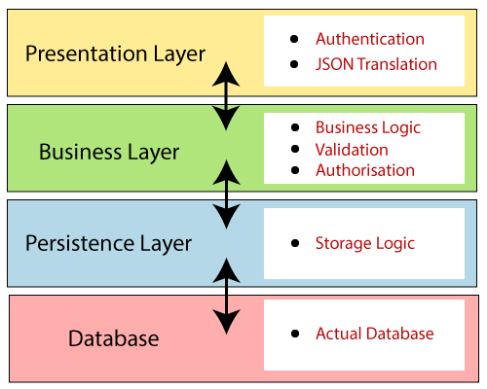
Spring Boot Architecture
Spring Boot follows a layered architecture in which each layer communicates with the layer directly below or above (hierarchical structure) it.
There are four layers in Spring Boot are as follows:
- Presentation Layer
- Business Layer
- Persistence Layer
- Database Layer

Slide 15
Spring Boot Architecture
Presentation Layer :
- The presentation layer handles the HTTP requests, translates the JSON
parameter to object, and authenticates the request and transfer it to the
business layer.
- In short, it consists of views i.e., frontend part.
Business Layer :
- The business layer handles all the business logic.
- It consists of service classes and uses services provided by data access
layers.
- It also performs authorization and validation.

Slide 16
Spring Boot Architecture
Persistence Layer:
- The persistence layer contains all the storage logic and translates business
objects from and to database rows.
Database Layer:
- In the database layer, CRUD (create, retrieve, update, delete) operations
are performed.

Slide 17
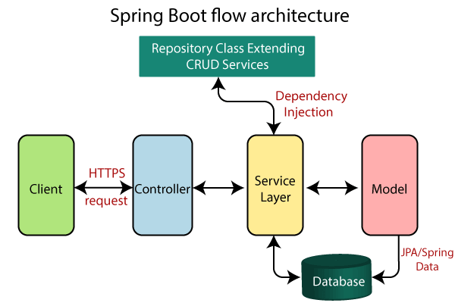
Spring Boot Flow Architecture

Slide 18
Spring Boot Annotations
@SpringBootApplication :
- A single @SpringBootApplication annotation is used to enable the following
annotations :
@EnableAutoConfiguration:
- It enables the Spring Boot auto-configuration mechanism.
@ComponentScan:
- It scans the package where the application is located.
@Configuration:
- It allows us to register extra beans in the context or import additional
configuration classes.

Slide 19
Spring Boot Annotations
Core Spring Framework Annotations :
@Required :
It applies to the bean setter method. It indicates that the annotated bean must be populated at configuration time with the required property, else it throws an exception BeanInitilizationException.
@Autowired :
Spring provides annotation-based auto-wiring by providing @Autowired annotation. It is used to autowire spring bean on setter methods, instance variable, and constructor. When we use @Autowired annotation, the spring container auto-wires the bean by matching data-type.
@Configuration:
It is a class-level annotation. The class annotated with @Configuration used by Spring Containers as a source of bean definitions
@Bean:
It is a method-level annotation. It is an alternative of XML <bean> tag. It tells the method to produce a bean to be managed by Spring Container.
@ComponentScan:
It is used when we want to scan a package for beans. It is used with the annotation @Configuration. We can also specify the base packages to scan for Spring Components.

Slide 20
Spring Framework Stereotype Annotations
@Component:
It is a class-level annotation. It is used to mark a Java class as a bean. A Java class annotated with @Component is found during the classpath. The Spring Framework pick it up and configure it in the application context as a Spring Bean.
@Controller:
The @Controller is a class-level annotation. It is a specialization of @Component. It marks a class as a web request handler. It is often used to serve web pages. By default, it returns a string that indicates which route to redirect. It is mostly used with @RequestMapping annotation.
@Service:
It is also used at class level. It tells the Spring that class contains the business logic.
@Repository:
It is a class-level annotation. The repository is a DAOs (Data Access Object) that access the database directly. The repository does all the operations related to the database.

Slide 21
Spring Boot Annotations
@EnableAutoConfiguration:
It auto-configures the bean that is present in the classpath and configures it to run the methods. The use of this annotation is reduced in Spring Boot 1.2.0 release because developers provided an alternative of the annotation, i.e. @SpringBootApplication.
@SpringBootApplication:
It is a combination of three annotations @EnableAutoConfiguration, @ComponentScan, and @Configuration.

Slide 22
Spring MVC and REST Annotations
@RequestMapping: It is used to map the web requests. It has many optional elements like consumes, header, method, name, params, path, produces, and value. We use it with the class as well as the method.
@RequestBody: It is used to bind HTTP request with an object in a method parameter. Internally it uses HTTP MessageConverters to convert the body of the request. When we annotate a method parameter with @RequestBody, the Spring framework binds the incoming HTTP request body to that parameter.
@ResponseBody: It binds the method return value to the response body. It tells the Spring Boot Framework to serialize a return an object into JSON and XML format.
@PathVariable: It is used to extract the values from the URI. It is most suitable for the RESTful web service, where the URL contains a path variable. We can define multiple @PathVariable in a method.
@RestController: It can be considered as a combination of @Controller and @ResponseBody annotations. The @RestController annotation is itself annotated with the @ResponseBody annotation. It eliminates the need for annotating each method with @ResponseBody.

Slide 23
Spring MVC and REST Annotations
@GetMapping: It maps the HTTP GET requests on the specific handler method. It is used to create a web service endpoint that fetches It is used instead of using: @RequestMapping(method = RequestMethod.GET)
@PostMapping: It maps the HTTP POST requests on the specific handler method. It is used to create a web service endpoint that creates It is used instead of using: @RequestMapping(method = RequestMethod.POST)
@PutMapping: It maps the HTTP PUT requests on the specific handler method. It is used to create a web service endpoint that creates or updates It is used instead of using: @RequestMapping(method = RequestMethod.PUT)
@DeleteMapping: It maps the HTTP DELETE requests on the specific handler method. It is used to create a web service endpoint that deletes a resource. It is used instead of using: @RequestMapping(method = RequestMethod.DELETE)

Slide 24
Spring Boot Dependency Management
Spring Boot manages dependencies and configuration automatically.
Each release of Spring Boot provides a list of dependencies that it supports.
We need not to specify the version of the dependencies in our configuration, Spring Boot manages itself.
Spring Boot upgrades all dependencies automatically in a consistent way when we update the Spring Boot version.

Slide 25
Advantages of Dependency Management
It provides the centralization of dependency information by specifying the Spring Boot version in one place.
It helps when we switch from one version to another.
It avoids mismatch of different versions of Spring Boot libraries.
We only need to write a library name with specifying the version. It is helpful in multi-module projects.

Slide 26
Spring Boot Application Properties
Spring Boot Framework comes with a built-in mechanism for application configuration using a file called application.properties.
It is located inside the src/main/resources folder.
Spring Boot provides various properties that can be configured in the application.properties file.
The properties have default values.
We can set a property(s) for the Spring Boot application. Spring Boot also allows us to define our own property if required.
The application.properties file allows us to run an application in a different environment.

Slide 27
Spring Boot Starters
Spring Boot provides a number of starters that allow us to add jars in the classpath.
Spring Boot built-in starters make development easier and rapid.
Spring Boot Starters are the dependency descriptors.
In the Spring Boot Framework, all the starters follow a similar naming pattern: spring-boot-starter-*, where * denotes a particular type of application. For example, if we want to use Spring and JPA for database access, we need to include the spring-boot-starter-data-jpa dependency in our pom.xml file of the project.

